Slide 1
Understanding Spotify Track Popularity
Akhil Ajith

Slide 2
#
Research Questions
1
Is track popularity evenly distributed, or concentrated among a small number of songs?
2
How are artist popularity and follower count related to track popularity?
3
Do explicit tracks differ in popularity compared to non-explicit tracks?
4
Are certain genres, album types, or release periods associated with higher popularity?
5
Can simple rule-based logic be used to identify potential hit songs?

Slide 3
Data
#
Feature Type
Columns
1
Track-level
Popularity, duration, explicit flag
2
Artist-level
Artist popularity, followers
3
Categorical
Genre, album type
4
Temporal
Release year

Slide 4
Data Cleaning and Wrangling Strategy
Steps:
Cleaned and standardized text fields, and handled missing values
Fixed data types and extracted the release year from album dates
Processed genre information and assigned one main genre per track
Removed unrealistic or invalid entries (e.g., impossible popularity or duration values)
Removed duplicate tracks and combined repeated versions of the same song
Created additional features such as track length in minutes
Performed final checks to ensure the dataset was complete and consistent

Slide 5
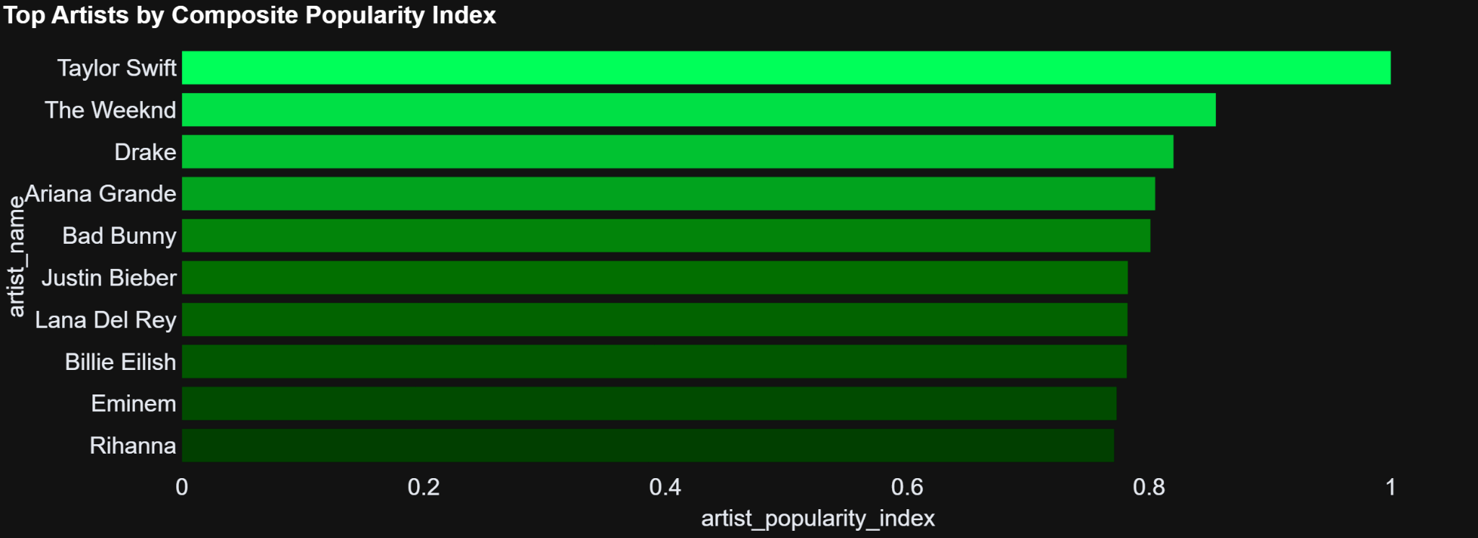
Top 10 artists
Artists are ranked using a combined popularity index based on artist popularity, followers, and track count.
Features are normalized and weighted to reflect overall visibility, with emphasis on artist popularity.

Slide 6
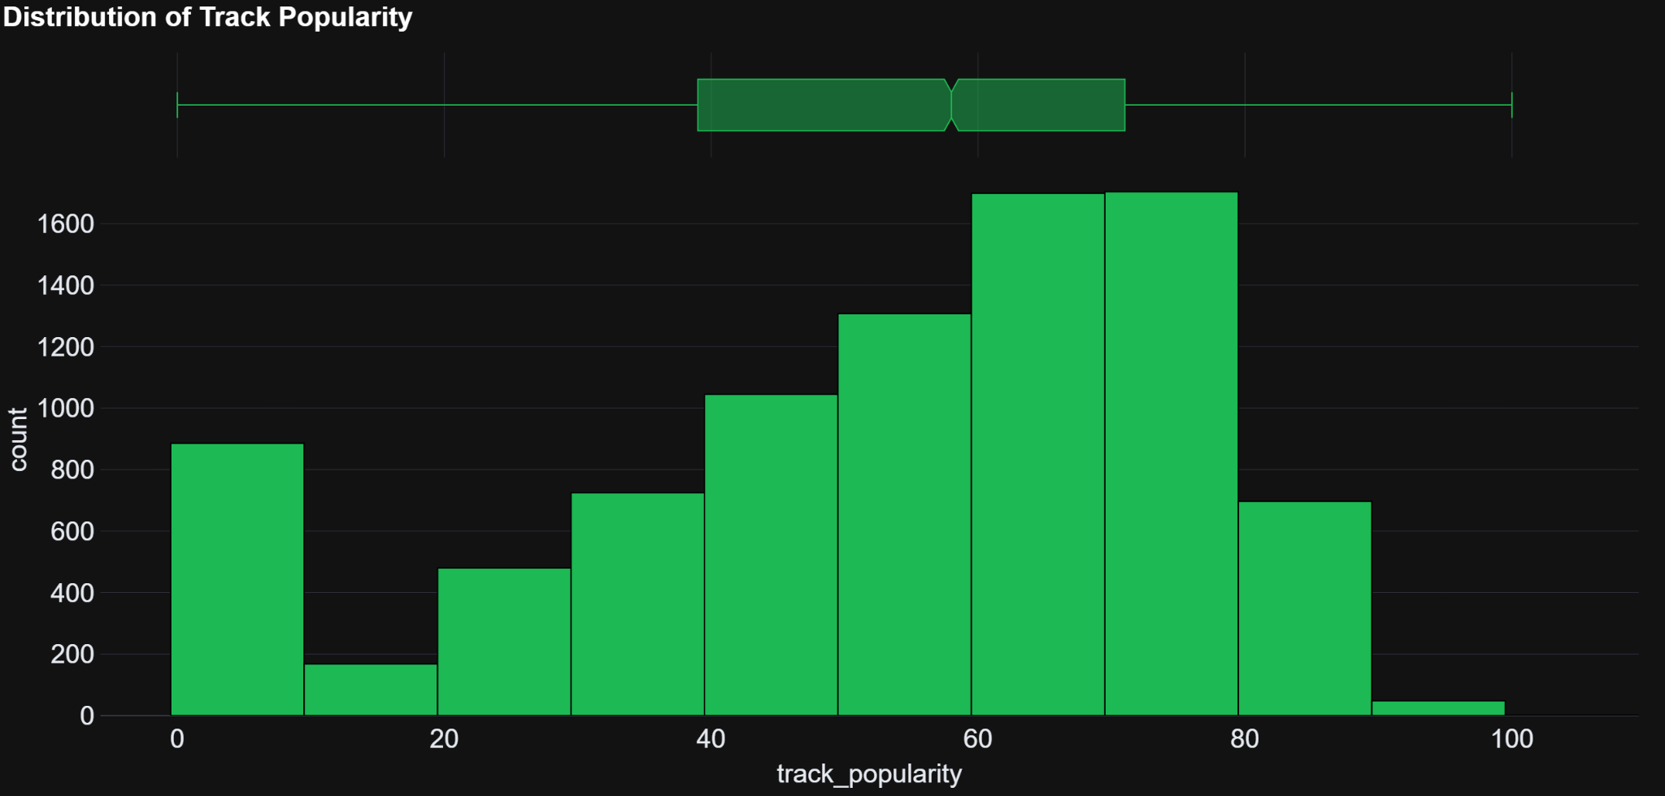
Track Popularity Is Highly Uneven
Track popularity is highly uneven, with many songs receiving little attention and only a small fraction becoming very popular. This skewed pattern reflects strong competition on the platform.

Slide 7
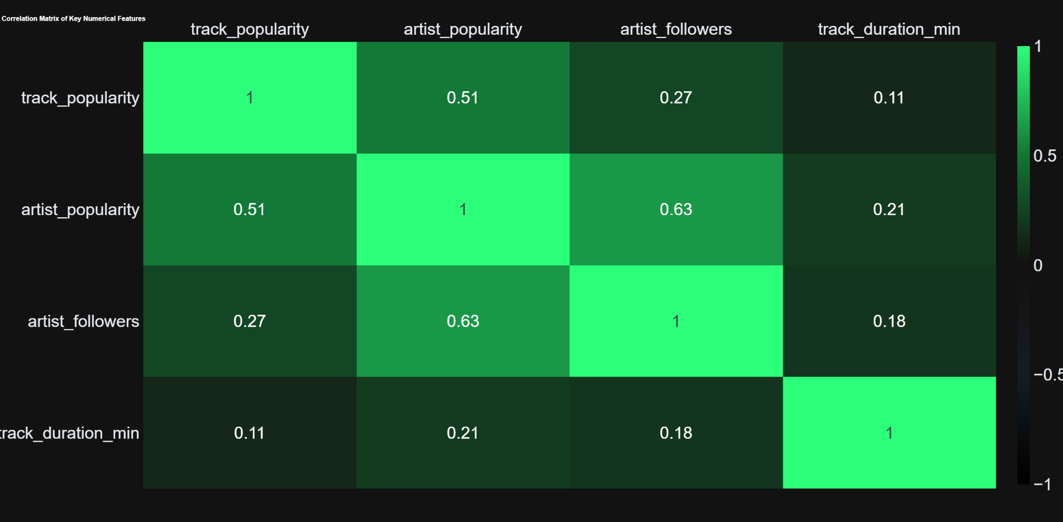

Artist Visibility Matters More Than Track Features
Artist-level variables show the strongest relationship with track popularity, while track-specific features contribute much less. This suggests that artist visibility matters more than technical song attributes.

Slide 8
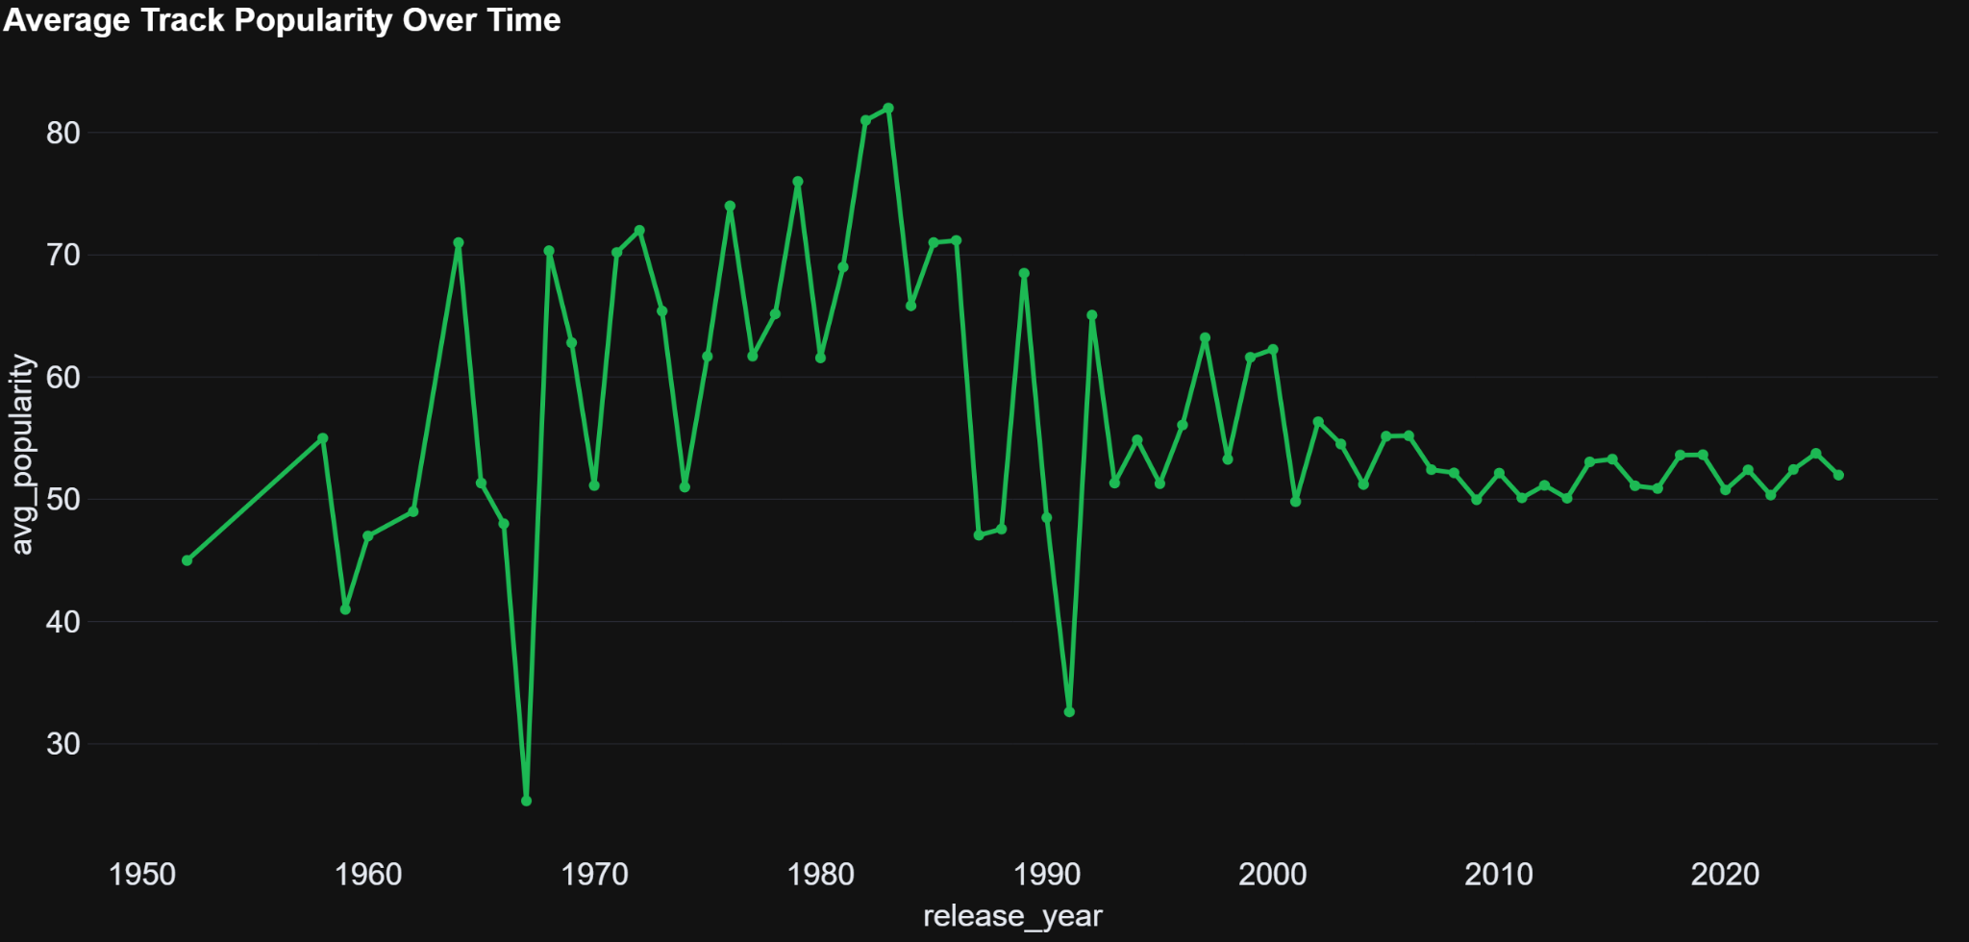
Popularity Patterns Stabilize Over Time
Early years show volatile averages due to limited data, while recent years are more stable. This indicates that current popularity patterns are reliable and structurally consistent.

Slide 9
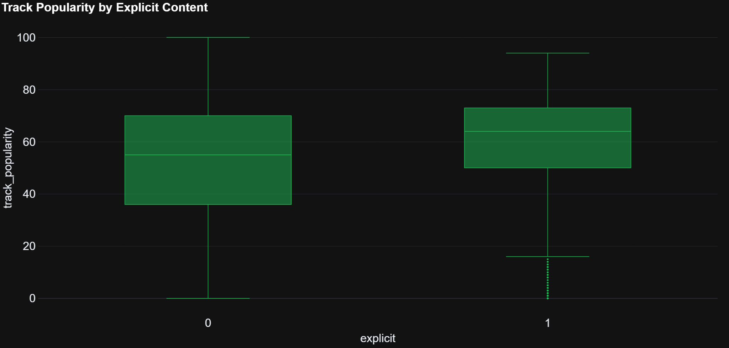
Explicit Content Does Not Guarantee Success
Explicit tracks have slightly higher median popularity, but the heavy overlap between groups shows that explicit content alone does not drive success.

Slide 10
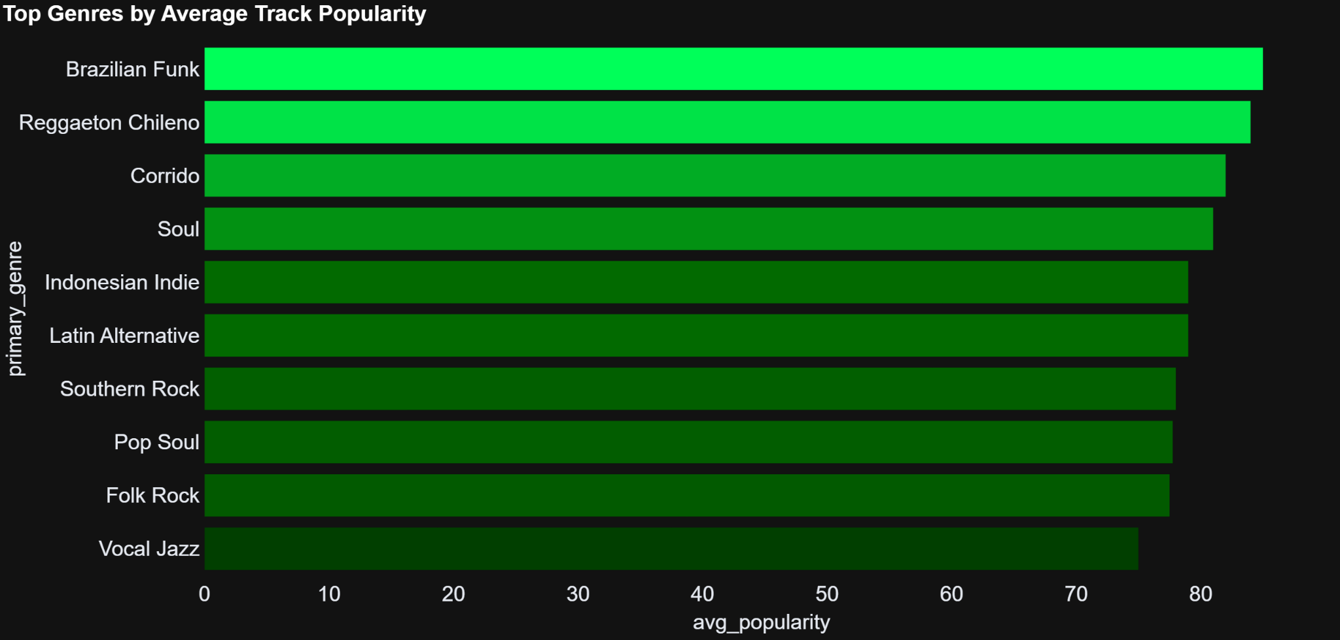
High Average Popularity Can Be Misleading
Some niche genres rank highly by average popularity, often due to small sample sizes. Average popularity should therefore be interpreted alongside genre frequency.

Slide 11
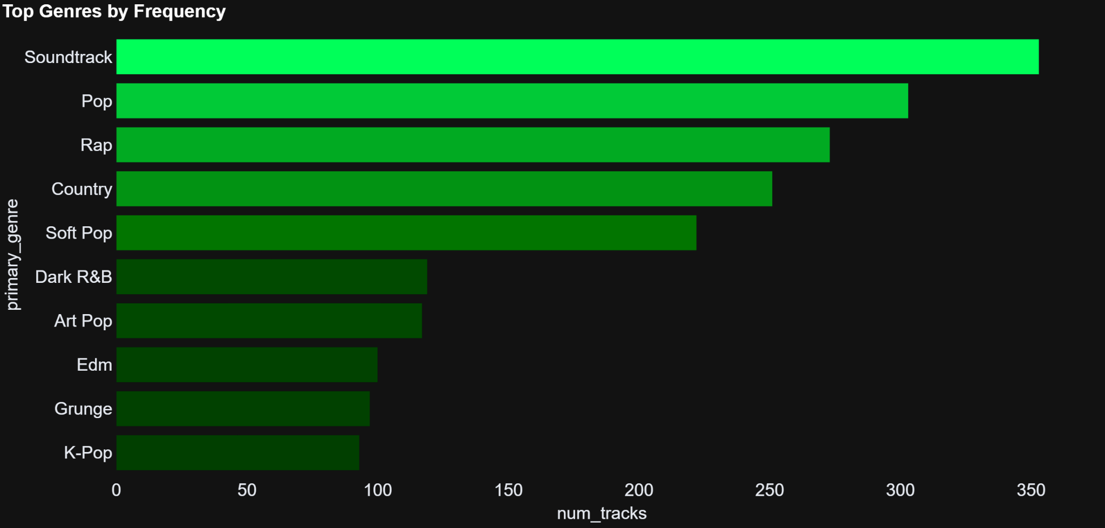
Popularity and Frequency Are Not the Same
High-frequency genres dominate the dataset but are not always the most successful on average. This highlights the difference between genre saturation and performance.

Slide 12
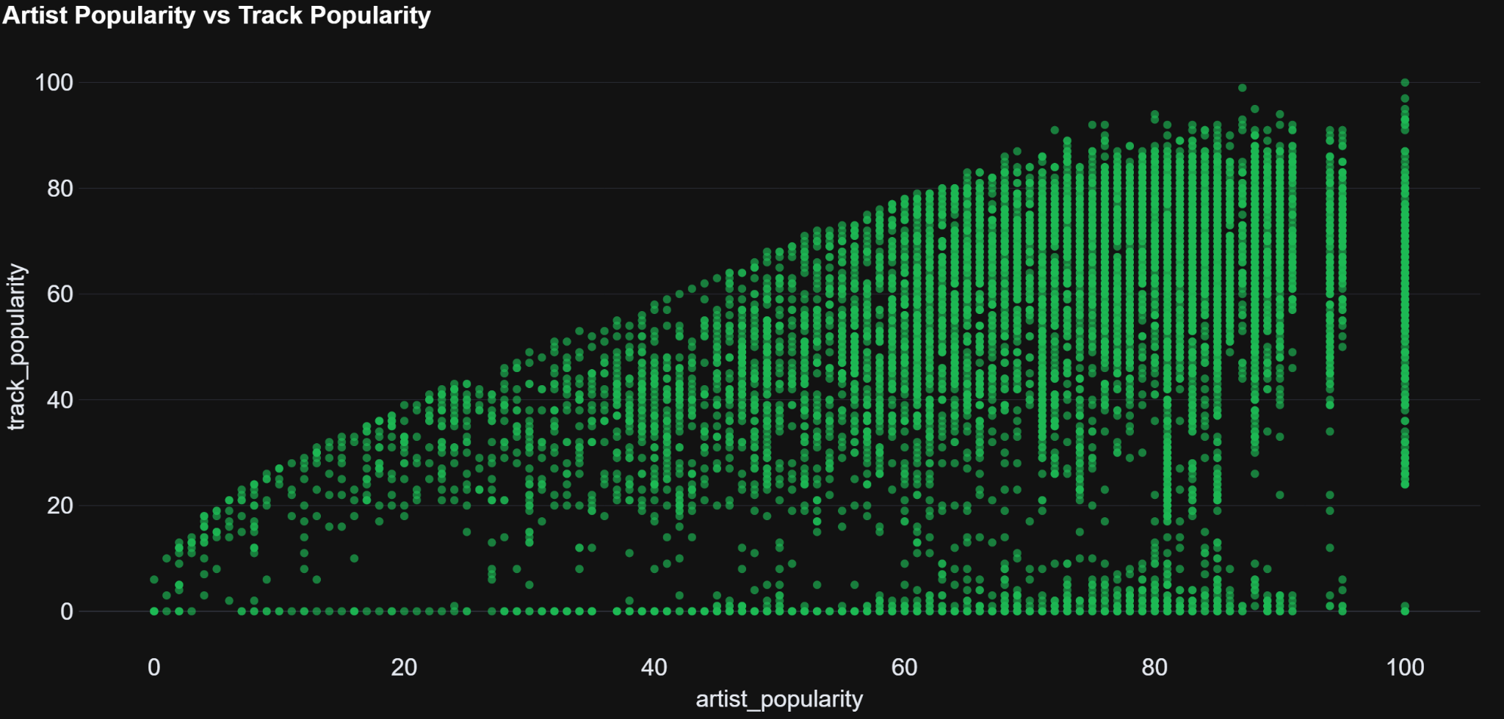
Artist Popularity Increases Upside Potential
Higher artist popularity increases the likelihood of success, but outcomes remain highly variable. Visibility raises potential without guaranteeing popularity.

Slide 13
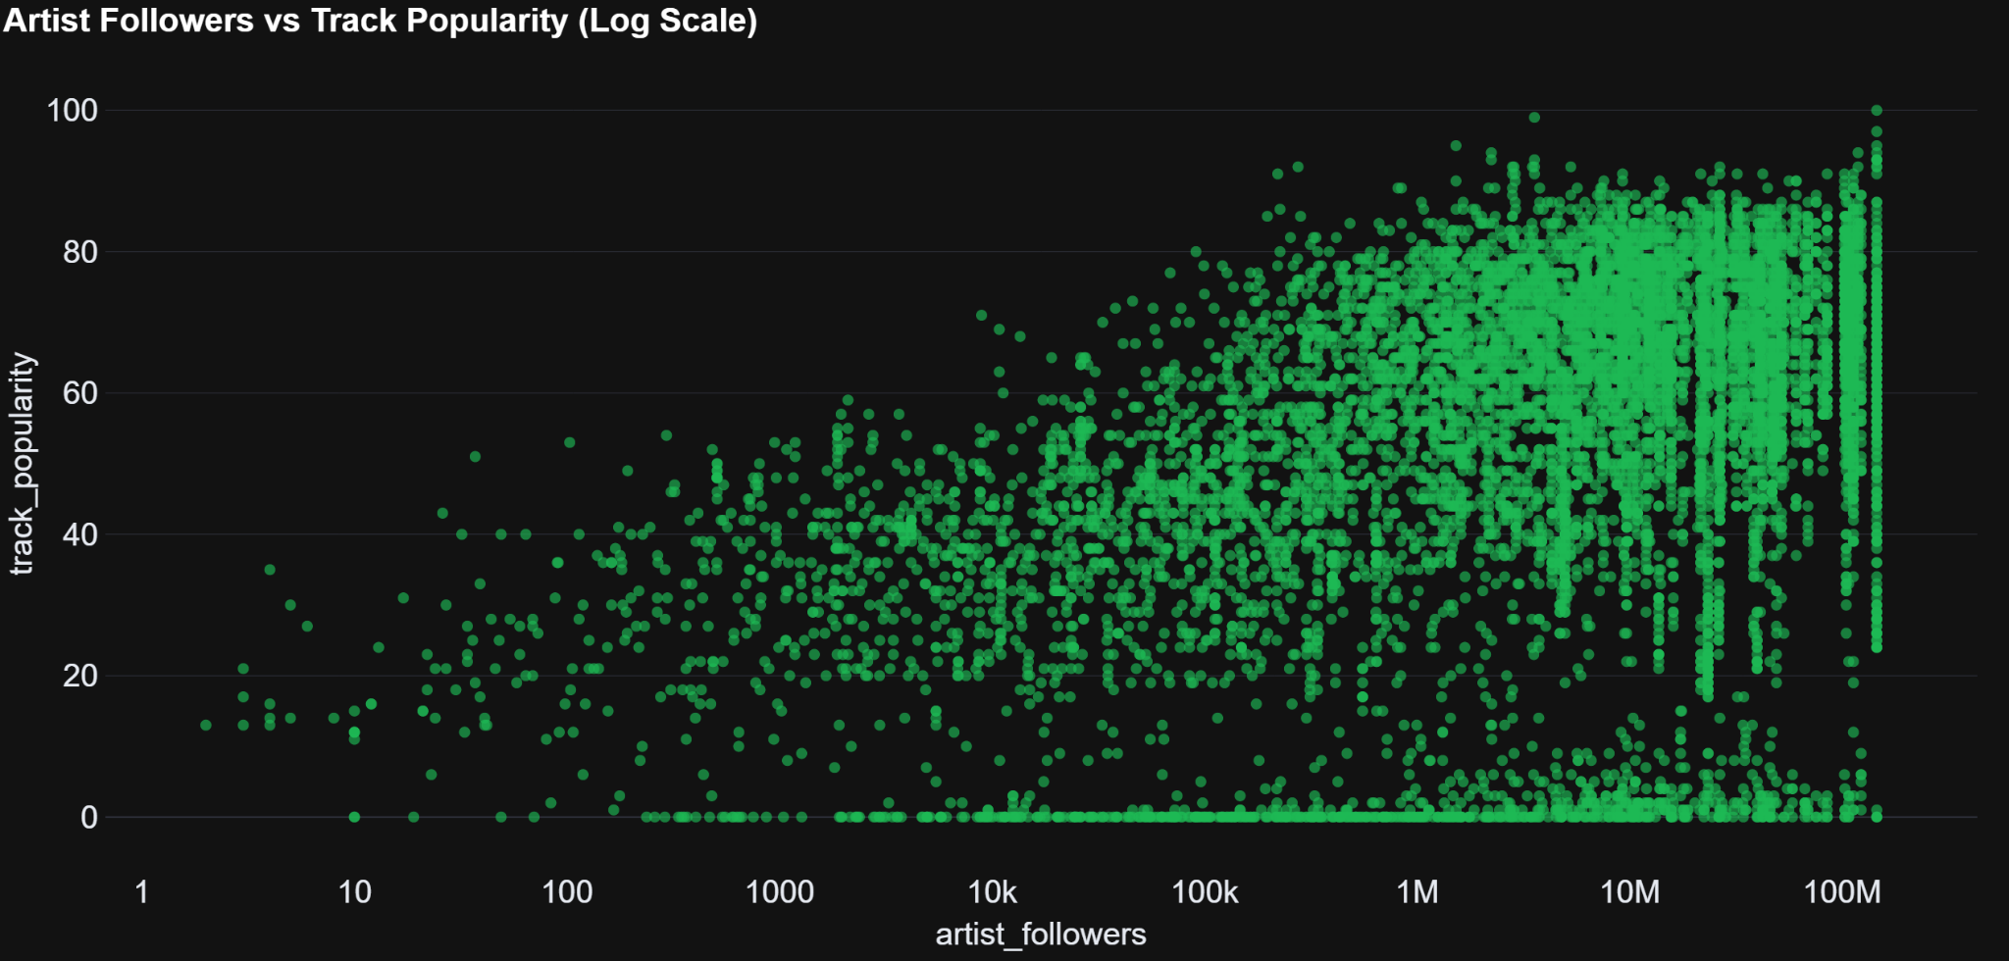
Audience Size Reflects Potential, Not Engagement
Follower count reflects potential reach but shows a noisy relationship with track popularity. Compared to artist popularity, it is a weaker indicator of success.

Slide 14
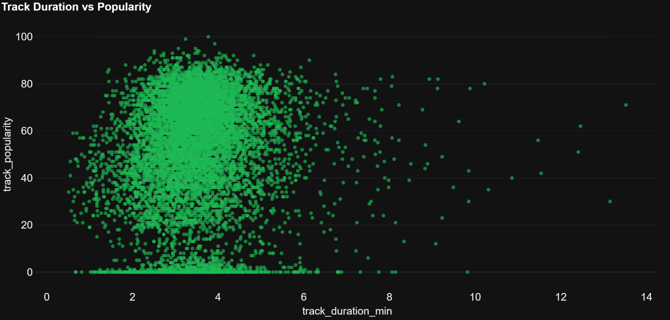
Track Length Has Little Impact on Popularity
Most tracks cluster around standard lengths regardless of popularity. This suggests track duration has little impact on performance.

Slide 15
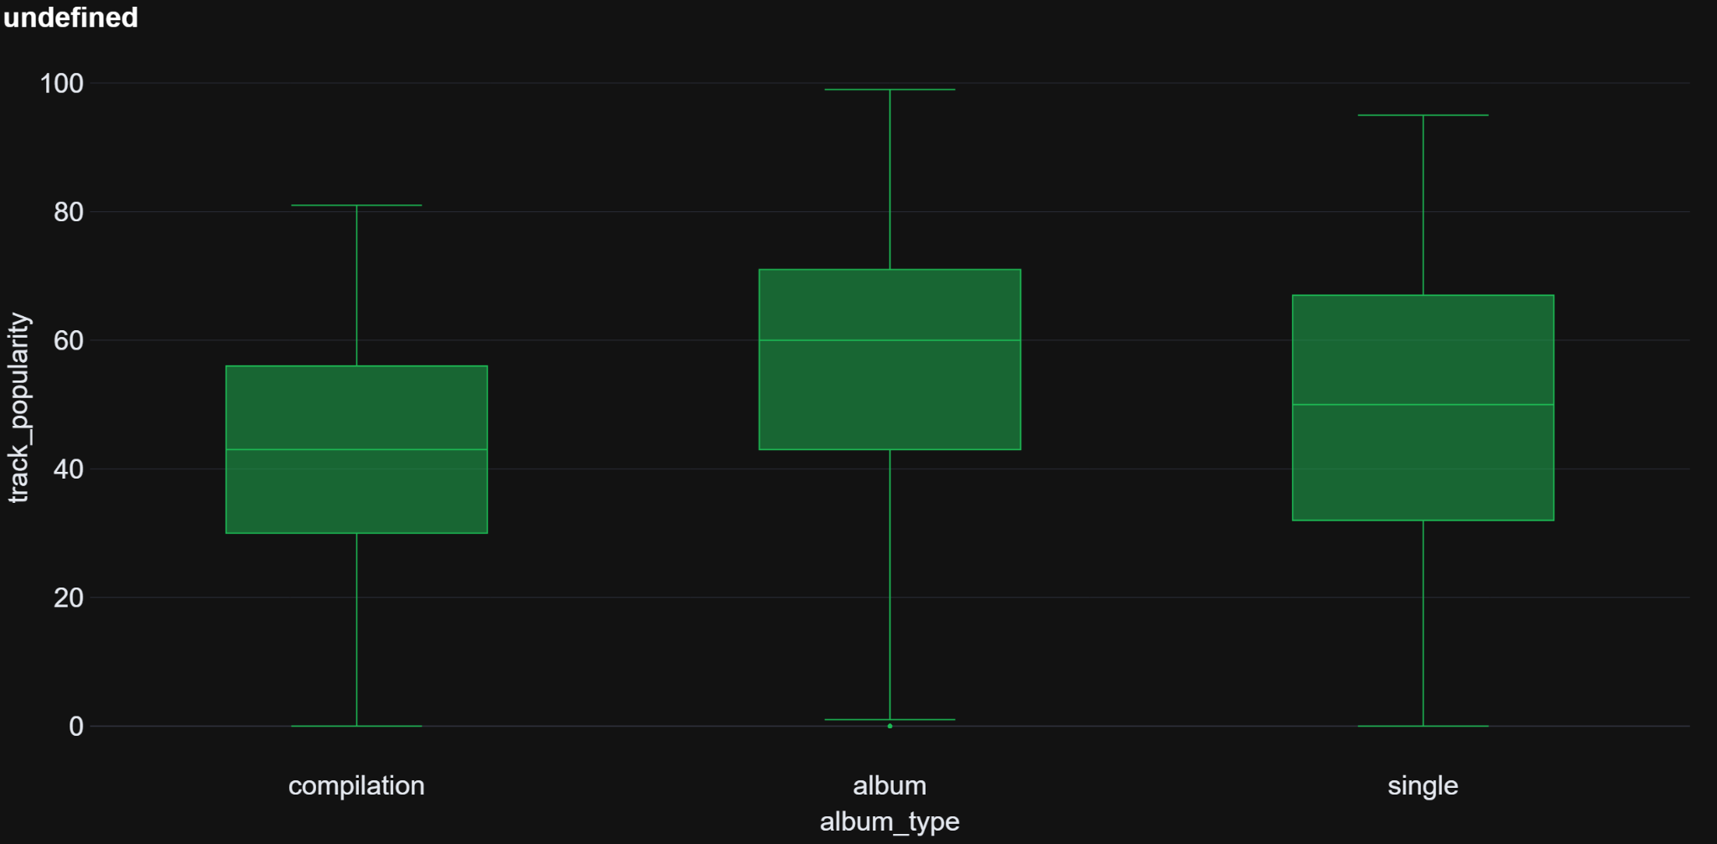
Album Releases Perform Slightly Better on Average
Album tracks show slightly higher median popularity than singles or compilations, but strong overlap indicates album type alone does not determine success.

Slide 16
Simple Rule-Based Hit Identification
Predicted Hit
Predicted Non-Hit
Actual Hit
1955
849
Actual Non-hit
2354
3603
How the rule works
A track is a hit if it falls in the top 30% of track popularity
A track is predicted as a hit if:
  Artist popularity ≥ 75
  Artist followers ≥ 1,000,000
What I learned
Artist visibility strongly increases the chance of success
Many tracks by popular artists still fail
Useful for understanding and screening, but not precise enough for prediction

Slide 17
Similarity Score: Approach & Observations
How the rule works
Chose a highly popular song as a reference point
Compared other tracks using artist popularity, audience size, and track duration
Normalized all features to ensure fair comparison
Calculated a similarity score showing how close each track is to the reference
What I learned
Tracks by the same or similarly popular artists appear closest to the reference
Artist popularity decreases gradually as similarity scores increase
Track popularity itself does not follow a clear pattern
Individual song success remains difficult to predict

Slide 18
Final Research Findings
Popularity is highly concentrated
Most tracks receive little attention, while a small number capture most engagement.
Artist visibility matters most
Tracks by popular artists with large audiences tend to perform better, but success is not guaranteed.
Explicit content has little impact
Explicit and non-explicit tracks show very similar popularity patterns.
Genre, album type, and timing matter indirectly
Some genres and formats perform better on average, but competition and artist visibility play a bigger role.
Simple rules help, but are limited
Rule-based logic can identify some popular tracks, but it also produces many false positives.

Slide 19
Demo

Slide 20
Thanks !

